Slide 1




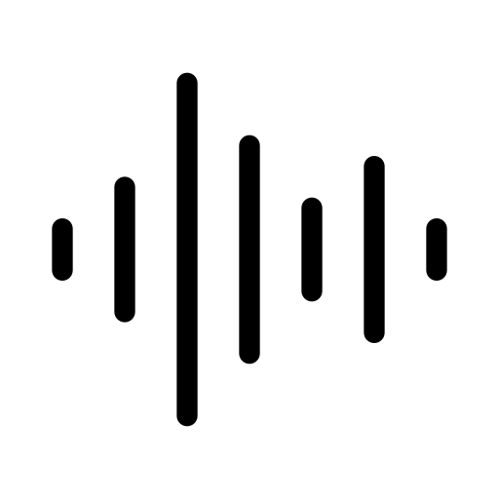
AI-Assisted Therapeutic Insight Extraction
Template 4.1: Orchestrating AI Models to Achieve a Goal
Icons: www.freepik.com (free license)
Notes:
My project is titled AI-Assisted Therapeutic Insight Extraction.
It’s based on Template 4.1: Orchestrating AI Models to Achieve a Goal.
CLICK
The goal is to automate one of the most repetitive aspects of therapy preparation CLICK
— analyzing written and spoken records to extract key insights.
This prototype demonstrates a proof-of-concept system that unites multiple AI models to convert therapist notes or voice memos into structured, meaningful summaries.
CLICK
Rather than a full application, it focuses on the technical orchestration and modular comparison of these models.

Slide 2



Motivation
Time constraints (Shaul et al., 2024).
Repetitive tasks.
Structured insights.
Vector and icons: www.freepik.com (free license)
Notes:
According to reports from mental-health professionals in a study by Shaul et al., CLICK therapists often face heavy workloads and limited time to review notes and prepare for sessions
Repetitive manual review of transcripts or journal reflections delays the real work CLICK, that is, deciding on the right therapeutic interventions.
By automating transcription and insight extraction CLICK, this system aims to reduce this bottleneck, giving professionals structured, data-driven insights in seconds rather than hours.

Slide 3
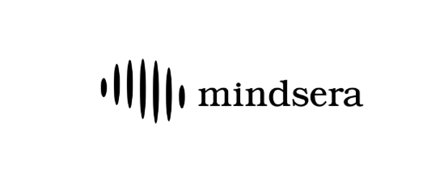
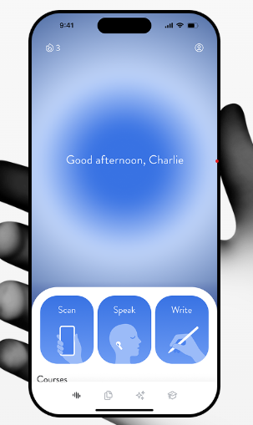



Mindsera: AI Journaling Assistant
(Mindsera, 2025)
What it does right.
Uses LLMs and NLP.
Journalling analysis and insights.
Multimodal inputs.
What it doesn’t do.
Provide model transparency.
Assist professionals.
Icons: www.freepik.com (free license)
Image: Mindsera logo, Mindsera screenshot www.mindsera.com
Notes:
One project that inspired this idea is Mindsera.
CLICK
It uses large language models to analyze personal journaling entries and, in turn, returns mindset reflections, progress feedback, and motivational insights.
It employs NLP for semantic similarity and emotional tone detection. CLICK
However, it is closed-source, with minimal transparency on model design or data handling.
This works well for individuals, but it doesn’t assist professionals or provide interpretability.
My project adapts this reflective approach to a professional setting, focusing on transparent model comparison and explainable insights that therapists can trust

Slide 4

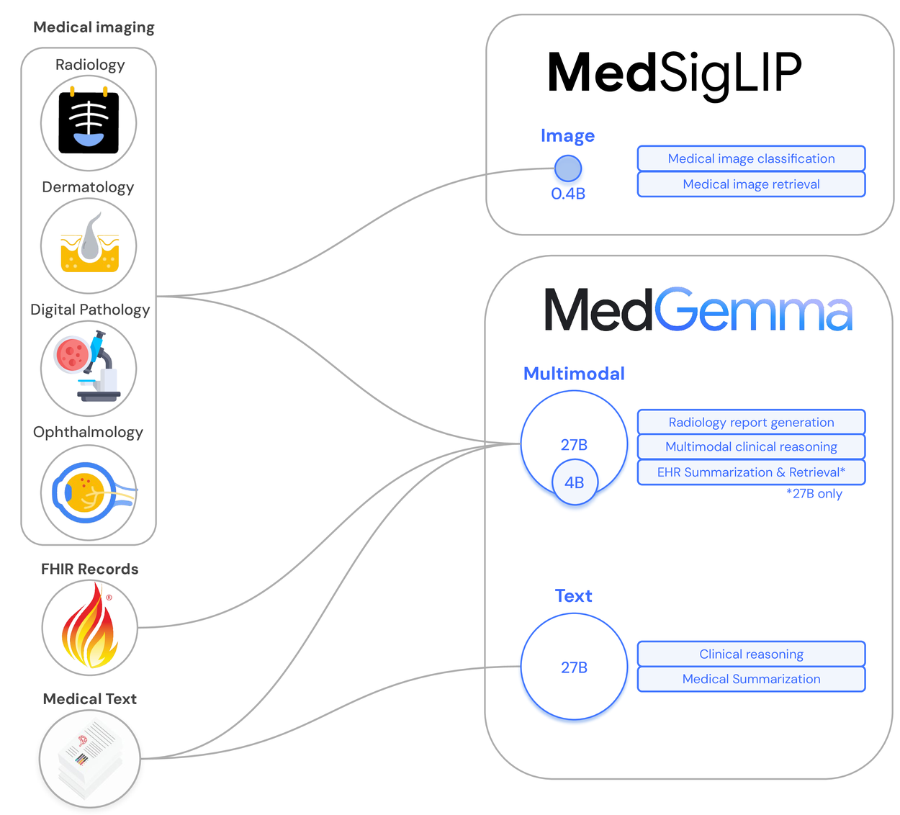
MedGemma
(Google Research, 2025)
What it does right.
Uses multimodal clinical data.
Returns structured information.
Transformer based encoding.
What it doesn’t do.
Target mental health.
Evaluate model combinations.
Icons: www.freepik.com (free license)
Image: Google APIs MedGemma Overview https://research.google/blog/?search=MedGemma
Notes:
Another reference point is MedGemma, Google Health’s multimodal model.
CLICK
It combines vision and text models to interpret clinical data — such as skin images, retinal scans, and handwritten doctor notes — producing structured diagnostic reports.
It does so by integrating transformer-based encoders for both text and image streams within a unified framework.
While its pipeline demonstrates exceptional multimodal orchestration CLICK, it is medical and diagnostic in nature.
My system extends the concept into mental health analysis, emphasizing reflective insights and evaluating how different models — OCR, ASR, NLP, and TTS — perform both individually and together.

Slide 5






Project Idea and Features
Icons and vector: www.freepik.com (free license)
Notes:
This will be a prototype that demonstrates a proof of concept, not a full web platform.
The user uploads either a scanned note or a voice memo CLICK — in the form of a simple file upload or drag-and-drop.
CLICK
The system returns insights as structured text and optional audio playback, summarizing emotional tone, key cognitive themes, and language patterns.
CLICK
This design tests the feasibility of AI-assisted reflection before developing a full interface.

Slide 6



Technical Implementation
Image/Audio Inputs
OCR/ASR
NLP
TTS
OCR
Tesseract (Smith, 2007)
Google Vision API (Google Cloud, 2025)
Easy OCR (JaidedAI, 2024)
ASR
OpenAI Whisper (Radford et al., 2023)
Vosk (Vosk, 2025)
Google Speech API (Google Cloud, 2025)
NLP
DistilBERT (Sahn et al., 2019)
RoBERTa (Liu et al. 2019)
TTS
Google TTS API (Google Cloud, 2025)
pyttsx3 (Bhat, 2021)
Coqui TTS (Coqui-AI, 2024)
Text/Audio Output
Icons: www.freepik.com (free license)
Notes:
The system is implemented in Python using a modular pipeline structure, allowing models to be interchanged and evaluated seamlessly.
For handwritten inputs as images CLICK, I’ll compare Tesseract, Google Vision API, and Easy OCR for OCR accuracy.
For audio inputs CLICK, OpenAI Whisper, Vosk, and Google Speech-to-Text API handle transcription.
CLICK
These outputs feed into DistilBERT and RoBERTa NLP models to detect sentiment and cognitive framing.
CLICK
Finally, Google TTS, pyttsx3, and Coqui TTS convert insights into natural-sounding audio summaries.
Each model can be swapped independently, enabling both individual and integrated performance evaluations — the essence of this orchestration template.

Slide 7





Evaluation Plan
OCR and ASR
NLP
TTS
Final Output
Icons: www.freepik.com (free license)
Notes:
Evaluation will measure both technical and interpretive performance.
CLICK
OCR and ASR outputs will be tested for transcription accuracy.
CLICK
NLP models will be assessed for precision, recall, and F1 across emotion and sentiment classes.
CLICK
For TTS, I’ll consider latency and subjective audio quality.
And since therapists rely on clarity CLICK, I’ll evaluate whether the insights remain concise as well as complete — ensuring they summarize without oversimplifying.

Slide 8

Less time reading, more time understanding
Vector: www.freepik.com (free license)
Notes:
In closing, this system helps therapists spend less time on repetitive review and more time on the human sides of therapy — empathy, connection, and interpretation.
By orchestrating vision, speech, and language models, it creates a flexible pipeline that can grow into future therapist-assisting tools.
This project demonstrates how modular AI orchestration can enhance mental-health practice CLICK — not by replacing the professional, but by empowering them.

Slide 9


Visual References
Icons @ www.freepik.com
picture, digital waveform, text, light bulb, speech bubble with waveform, clock, dashboard, cross, check, brain, bandage, slanted T, loading, text list, good audio, python logo, speech bubble with text, volume, accurate text, valid insights, good waveform, latency, interpretability, image references, academic references
Vectors @ www.freepik.com
work frustration, person insight, person insight desk
Mindsera logo and screenshot @ www.mindsera.com
Google APIs MedGemma Overview image @ https://research.google/blog/?search=MedGemma
Icon: www.freepik.com (free license)

Slide 10

Academic and Conceptual References
Mindsera. (2025) Mindsera: The Most Advanced AI-Powered Journal. [online] Available at: https://www.mindsera.com/ [Accessed 7 Nov 2025].
Google Research. (2025) MedGemma: Our most capable open models for Health AI development. [online] 9 July. Available at: https://research.google/blog/medgemma-our-most-capable-open-models-for-health-ai-development/ [Accessed 7 Nov 2025].
Smith, R. (2007) An Overview of the Tesseract OCR Engine. 9th International Conference on Document Analysis and Recognition, Brazil, 23-26 September. Available at: https://doi.org/10.1109/ICDAR.2007.4376991 [Accessed 7 Nov 2025].
Google Cloud. (2025) Cloud Vision API documentation. [online] Available at: https://cloud.google.com/vision/docs [Accessed 7 Nov 2025].
JaidedAI. (2024) EasyOCR: Ready-to-use OCR with 80+ supported languages. GitHub repository. Available at: https://github.com/JaidedAI/EasyOCR [Accessed 7 Nov 2025].
Radford, A. et al. (2023) Robust Speech Recognition via Large-Scale Weak Supervision (Whisper). OpenAI. Available at: https://cdn.openai.com/papers/whisper.pdf [Accessed 7 Nov 2025].
Vosk. (2025) Vosk Speech Recognition Toolkit. [online] Available at: https://alphacephei.com/vosk/ [Accessed 7 Nov 2025].
Google Cloud. (2025) Speech-to-Text API documentation. [online] Available at: https://cloud.google.com/speech-to-text/docs [Accessed 7 Nov 2025].
Sanh, V., Debut, L., Chaumond, J. & Wolf, T. (2019) DistilBERT, a distilled version of BERT: smaller, faster, cheaper and lighter. arXiv preprint arXiv:1910.01108. Available at: https://arxiv.org/abs/1910.01108 [Accessed 7 Nov 2025].
Liu, Y., Ott, M., Goyal, N., Du, J., Joshi, M., Chen, D., Levy, O., Lewis, M., Zettlemoyer, L. & Stoyanov, V. (2019) RoBERTa: A Robustly Optimized BERT Pretraining Approach. arXiv preprint arXiv:1907.11692. Available at: https://arxiv.org/abs/1907.11692 [Accessed 7 Nov 2025].
Google Cloud. (2025) Text-to-Speech API documentation. [online] Available at: https://cloud.google.com/text-to-speech/docs [Accessed 7 Nov 2025].
Bhat, N. M. (2021) pyttsx3 – Text-to-Speech x-platform (v2.6) documentation. [online] Available at: https://pyttsx3.readthedocs.io/ [Accessed 7 Nov 2025].
Coqui-AI. (2024) Coqui TTS: Library for advanced Text-to-Speech generation. [online] Available at: https://pypi.org/project/coqui-tts/ [Accessed 7 Nov 2025].
Icon: www.freepik.com (free license)

